Slide 1

How to create a project using STM32IDE
rev1.0_24-03-2020

Slide 2
GOAL
How to create a new project with STM32IDE software

Slide 3
PREREQUISITES
Software needed:
STM32IDE
Hardware used in this example:
NUCLEO-F446ZE

Slide 4
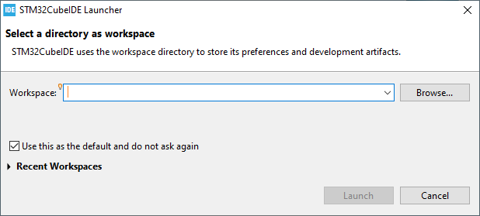
Start a new project
When you open the STM32IDE software for the first time, the following windows appears.
Choose a path for the workspace folder and click Launch.
The workspace folder will contain all the future projects.

Slide 5
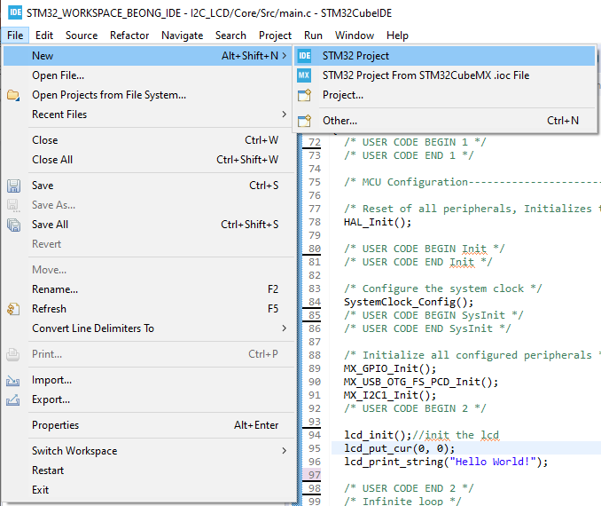
Start a new project
Click on file→ new→ STM32 project.
The project wizard will show up.

Slide 6
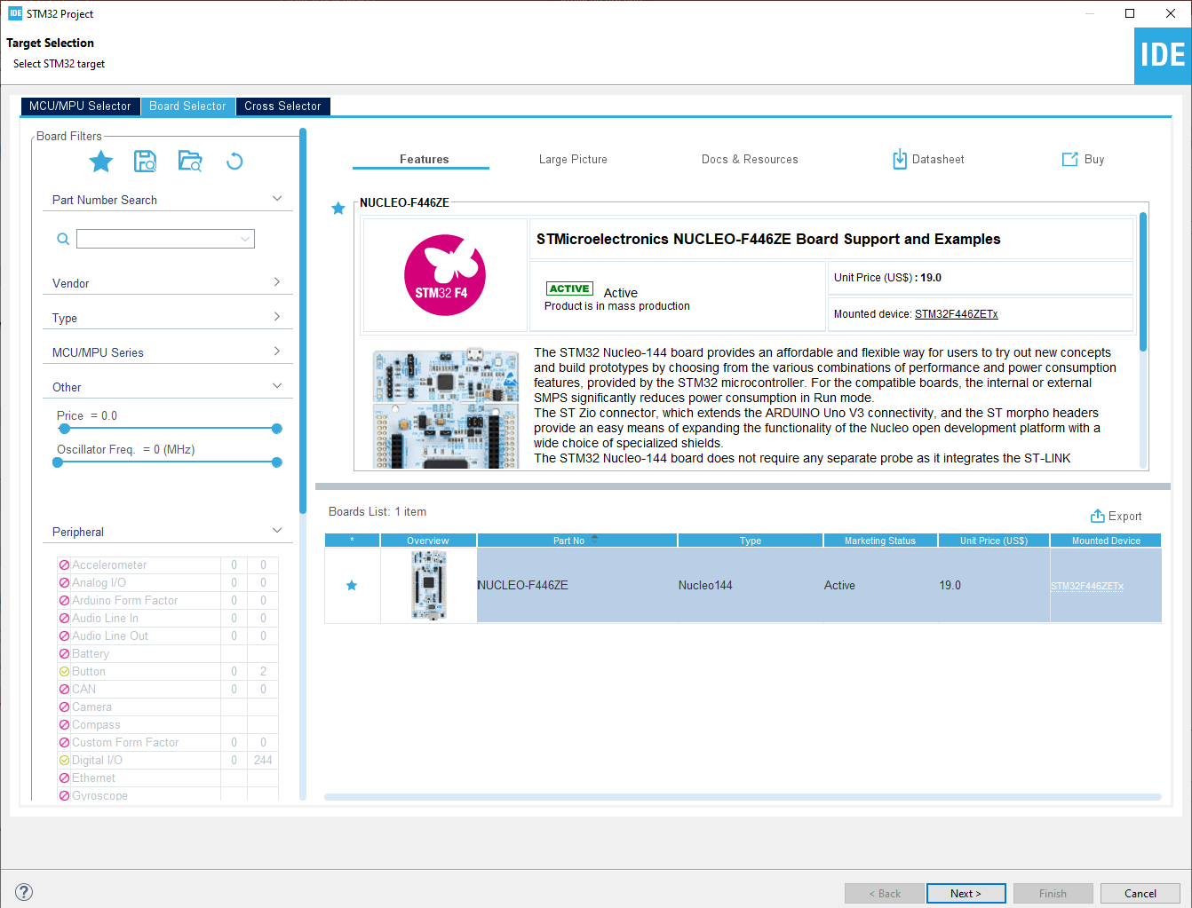
Start a new project
From this perspective we choose the uC that we are using for our application.
If you are developing your project on a dev-Board you can choose the board selector tab to find your board.
In our example we select the NUCLEO-F446ZE board.
It’s possible to add a list of favorite boards checking the star icon.
Select your desired board and click next.

Slide 7
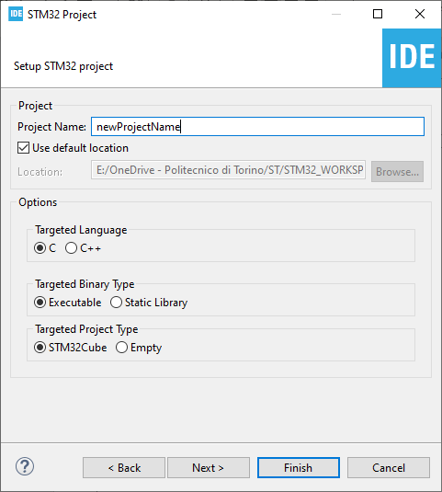
Start a new project
Type the name of your project and click next.
By default the project will be created in the workspace folder.

Slide 8
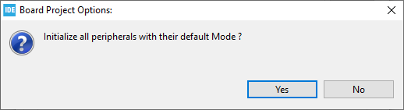
Start a new project
Type the name of your project and click next.
By default the project will be created in the workspace folder.
The STM32IDE has the option to initialize all the peripheral with their default mode:
Clicking Yes the USART3, all the LEDs and the blue UserButton will be configured as default.
Click Yes.

Slide 9
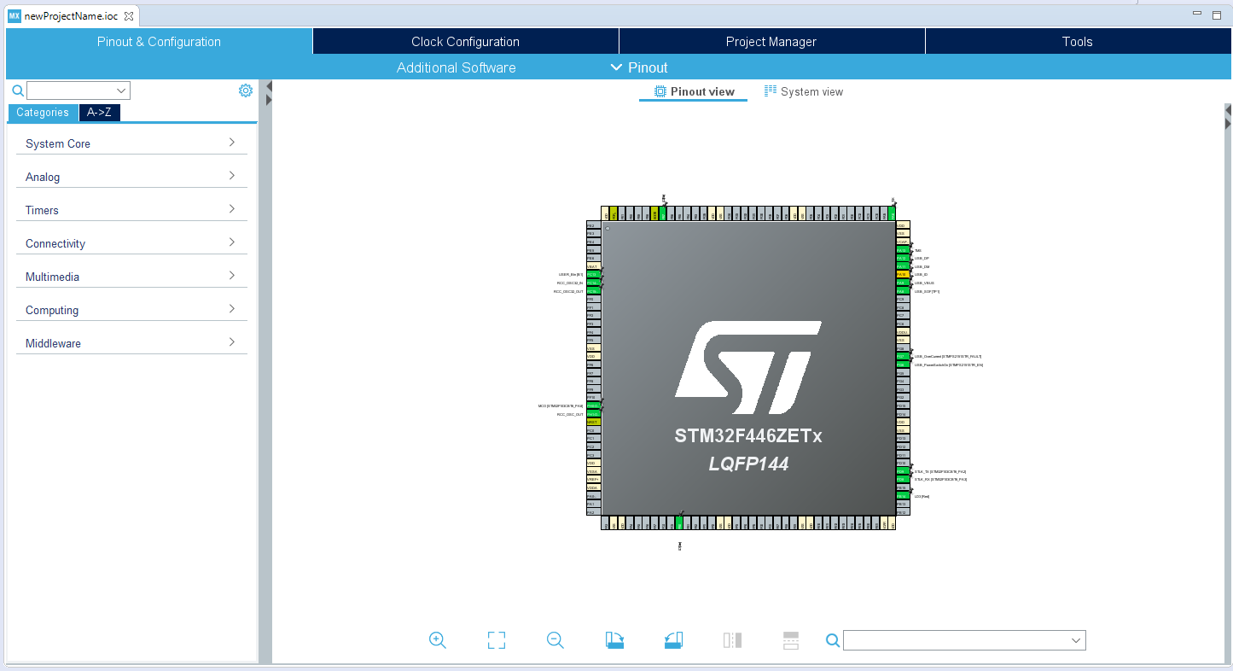
Device configuration tool Perspective
The “Device configuration tool Perspective” view will open (the old CubeMX).
This view is divided in four Tabs:
Pinout & configuration
Clock Configuration
Project Manager
Tools

Slide 10
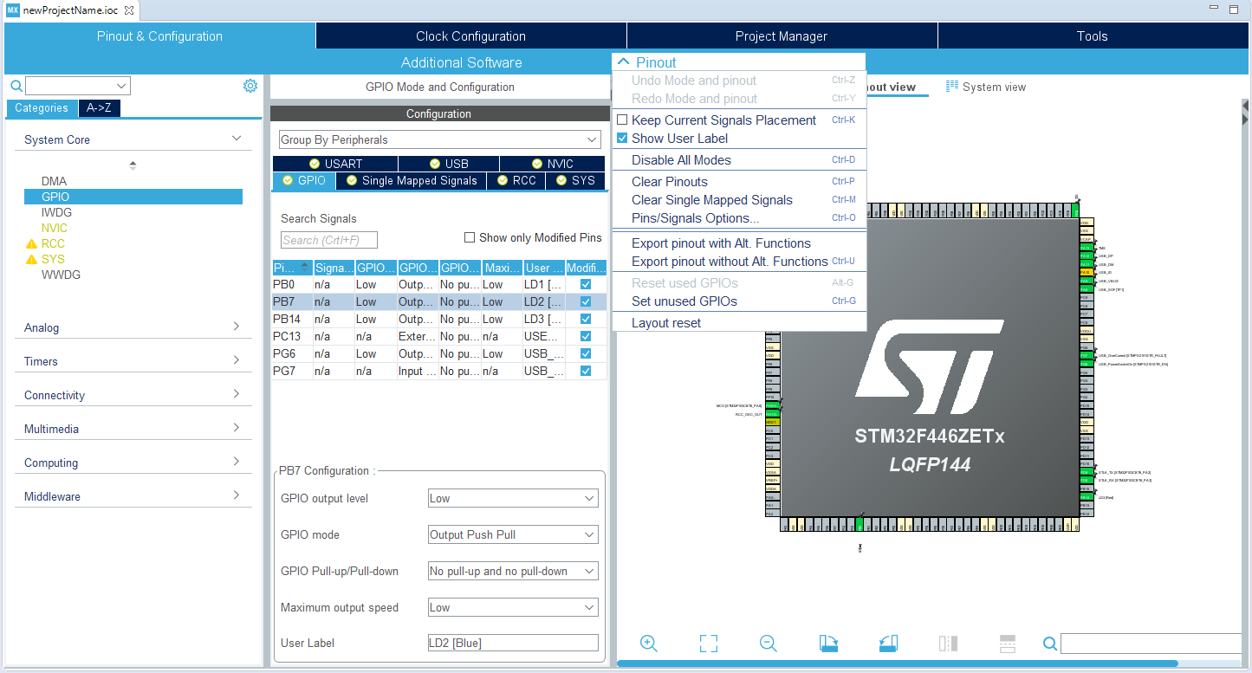
Pinout & Configuration
From this view It’s possible to configure all the peripherals needed for the project such as GPIO, Timers, I2C, USART, SPI, ecc.
If you have initialized the peripheral with their default value you can see a lot of green pins: the software configured those for us, such as the blue user button or the led mounted on the board.
If you wish, you can clear your pinout from the pinout menu.

Slide 11
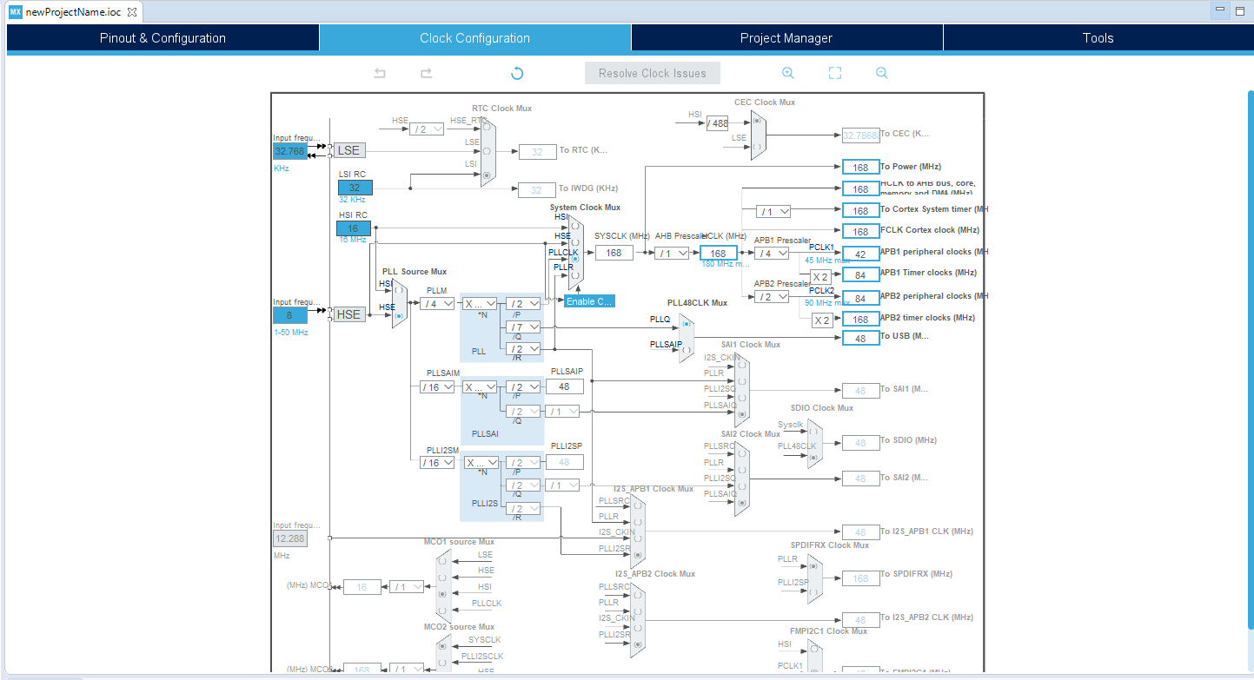
Clock
In the Clock Configuration you can define the clock frequency and sources for all the peripherals.
It’s very useful for application wherethe control on the clock frequency is needed: an example could be low power application where the clock frequency configuration is critical.

Slide 12
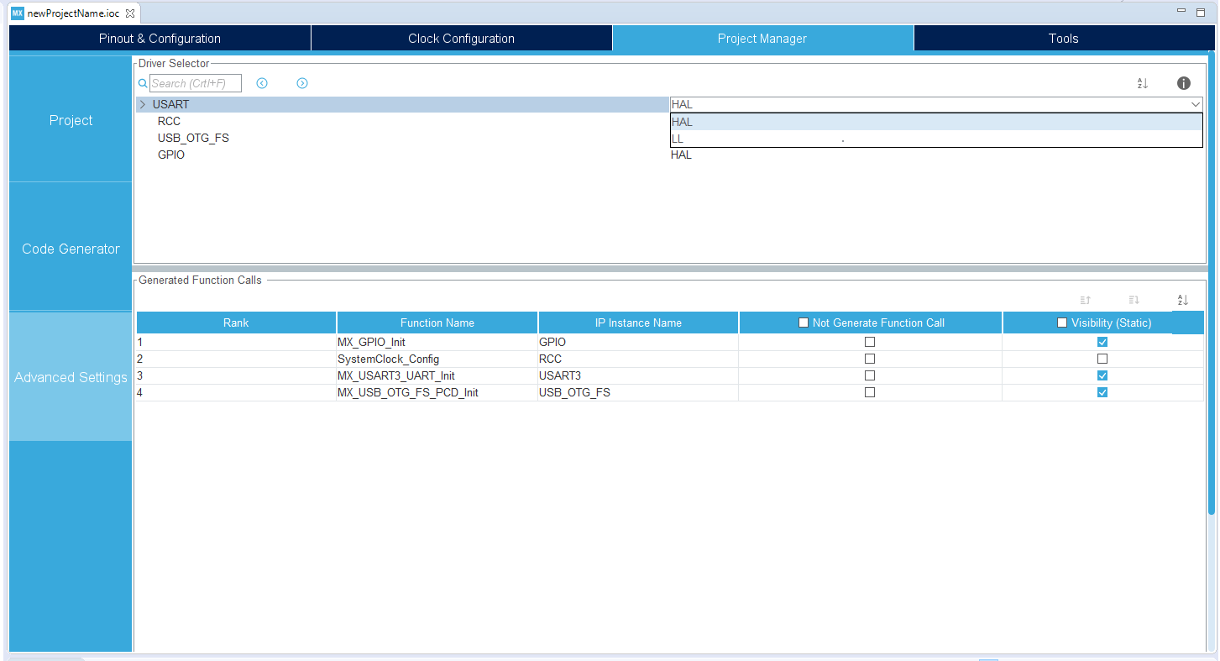
Project Manager
The Project Manager Tab is divided in 3 submenus. From here you can control for example the path of your project and so.
The most important tab is Advanced Setting : from here we can decide to use HAL or LL libraries to program the peripherals.

Slide 13
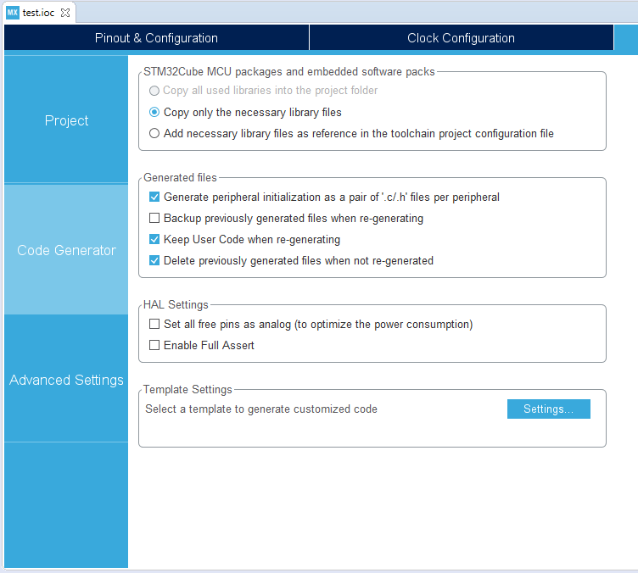
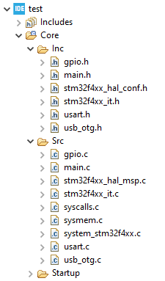
Project Manager
In the Code Generator Tab check the Generate peripheral initialization […] box: each periperhal will have a disting periph.c and periph.h files.

Slide 14
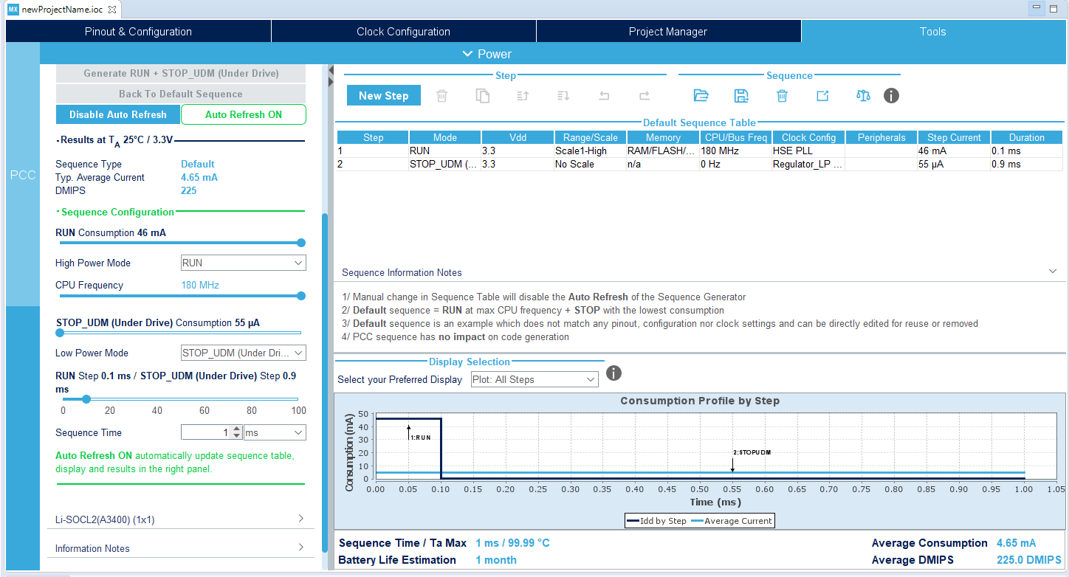
Tools
From the Tools tab it’s possible to simulate the behavior of the uC in terms of power consumption and have information about the battery life estimation, ecc.

Slide 15
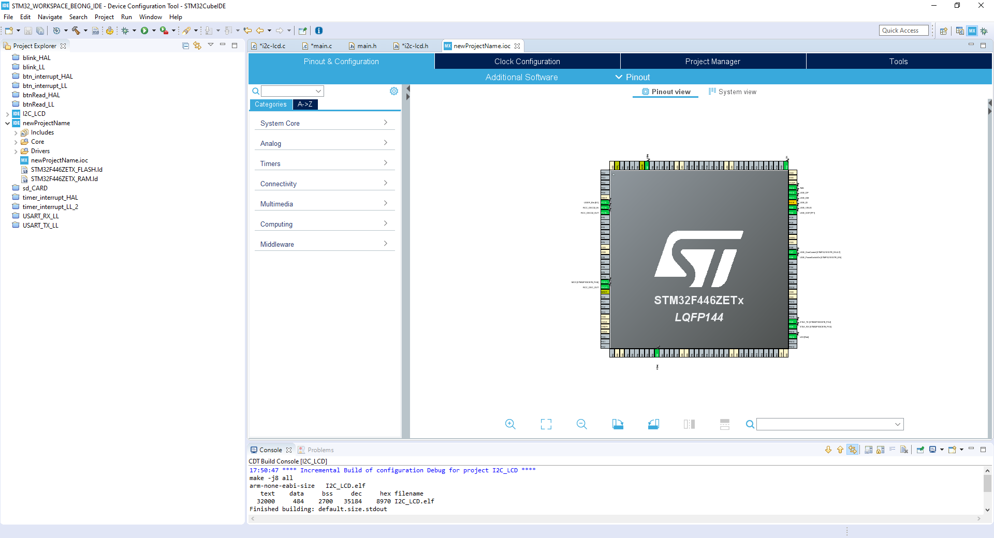

Code Generation
The next step is to generate the code: this process will generate all the files needed for the project such as the main.c and main.h files where it’s possible to find all the configuration functions generated for our application.
Click on the generate icon (the gear) to generate the code.

Slide 16
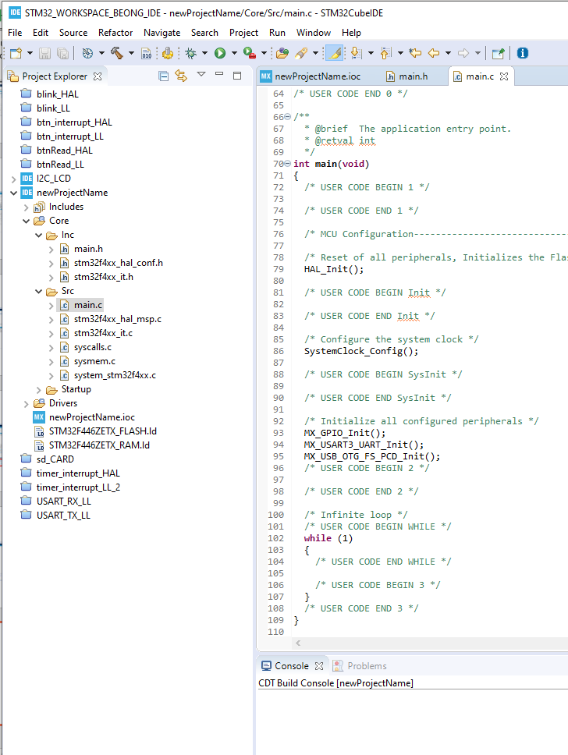
Project Explorer
On the left there is the Project Explorer where all the files are displayed.
From here you can manage your projects, add, remove or move files.

Slide 17
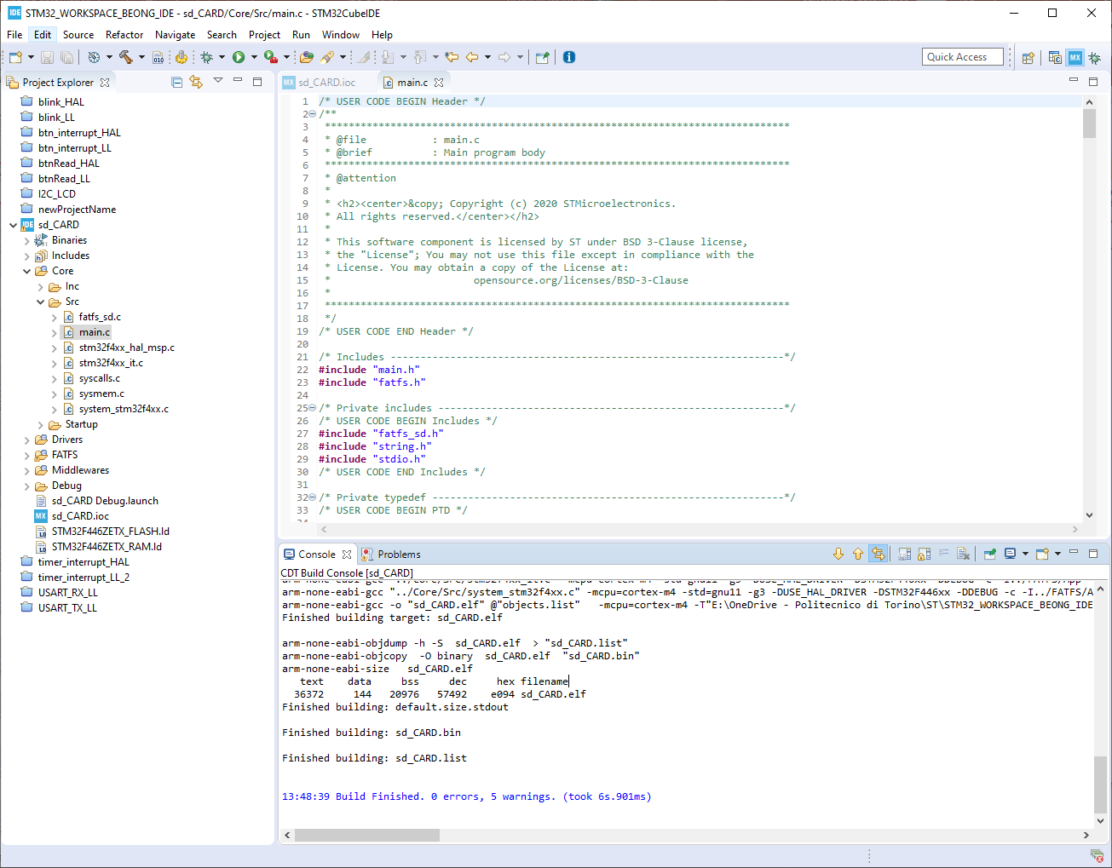

Build your project
Before run the program on your board it’s a good idea to check for errors:
Compile the project by clicking on the Build icon .
The result will be shown in the console box.
If there are non errors, continue by downloading the project to your board.

Slide 18
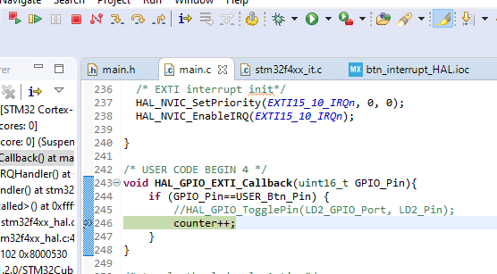
Download your Program on the board
In order to download the program on the board there are two ways:
Run: all the files will be download on the board and the program will start automatically
Debug: in this mode it’s possible to debug your application using breakpoints or moving step by step in the code using the arrows.
Debug
Run

